Slide 1
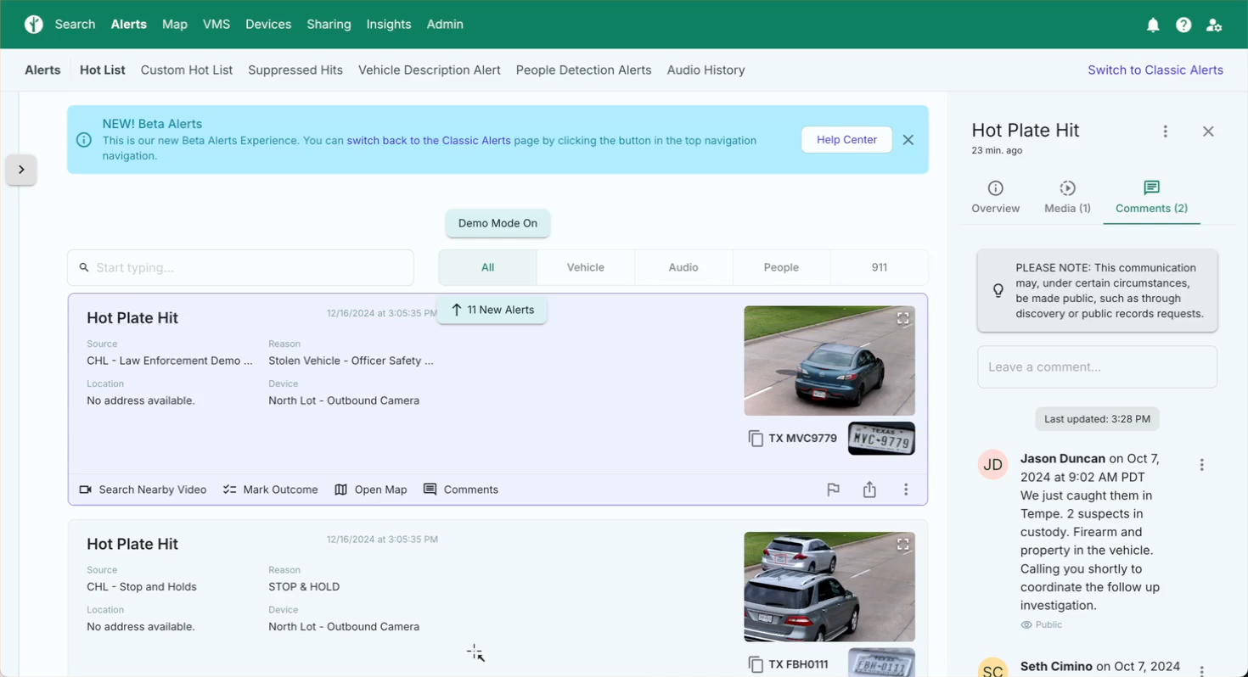
Flock Alerts Video
Notes:
Demonstrate this feature.

